Slide 1
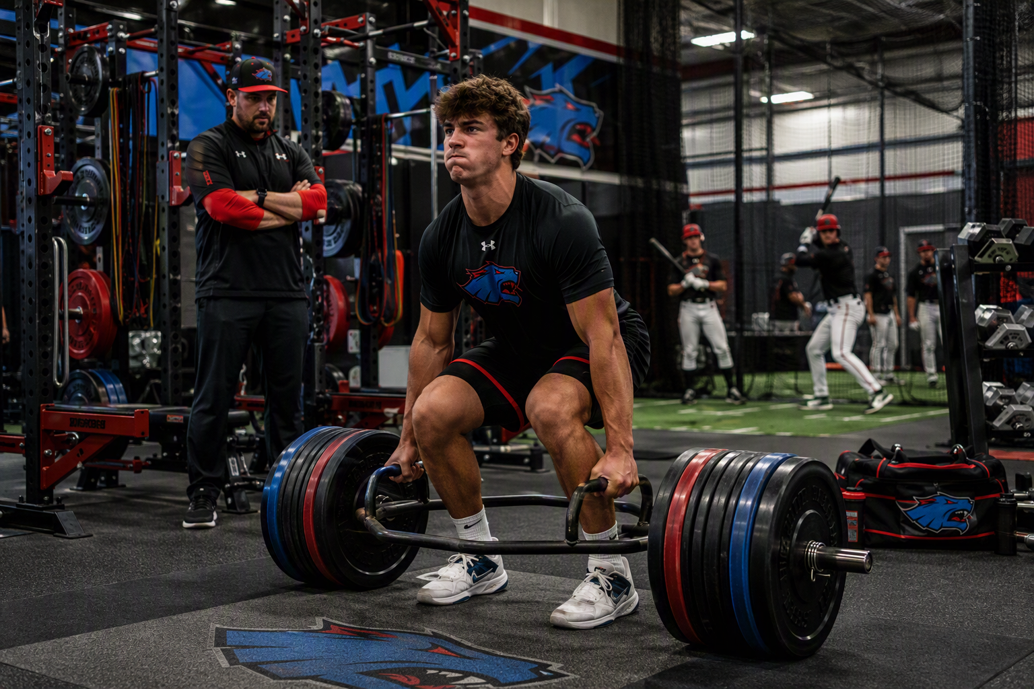
COAL CREEK HUSTLE | BASEBALL
THE NEW REALITY
OF COLLEGE BASEBALL
RECRUITING
A parent roadmap for the five-year eligibility era and the transfer-portal marketplace.
PARENT EDITION
2026–27
Notes:
[Sources]
Visual on this slide was generated with Microsoft Copilot.
Coal Creek Hustle logo treatment based on the official organization wordmark: https://coalcreekhustlebaseball.com/16u-2025/
[/Sources]

Slide 2
WHAT CHANGED
The five-year clock starts earlier than many families realize
01
DIVISION I
02
DIVISION II
5
Full implementation applies to prospects initially enrolling full time in fall 2027 or later.
Effective for 2026–27, with transition provisions for certain current athletes.
YEAR WINDOW
Not five guaranteed seasons
The eligibility clock generally begins at full-time college enrollment or the academic year after the athlete’s 19th birthday, whichever comes first.
Always confirm the individual case with the NCAA Eligibility Center and the college compliance office.
COAL CREEK HUSTLE • RECRUITING ROADMAP
02
Notes:
[Sources]
https://www.ncaa.org/division-i-adopts-age-based-eligibility-model/
https://www.ncaa.org/division-ii-adopts-age-based-eligibility-model/
[/Sources]

Slide 3
WHY RECRUITING FEELS DIFFERENT
The portal has become a major roster-building market
D1 and D2 staffs can address immediate needs with college-tested players.
01
02
03
PROVEN
DEVELOPED
IMMEDIATE
College statistics and verified performance
Greater strength, maturity and position polish
Ready to fill a roster need now
HIGH-SCHOOL PROSPECTS NOW COMPETE WITH OLDER, COLLEGE-TESTED ATHLETES
COAL CREEK HUSTLE • RECRUITING ROADMAP
03
Notes:
[Sources]
https://www.baseballamerica.com/stories/2026-college-baseball-transfer-portal-tracker/
https://www.diviibaseball.com/post/2026-d2-baseball-transfer-commit-tracker
https://baseballmode.com/blogs/blog/college-baseball-recruiting-transfer-portal
[/Sources]

Slide 4
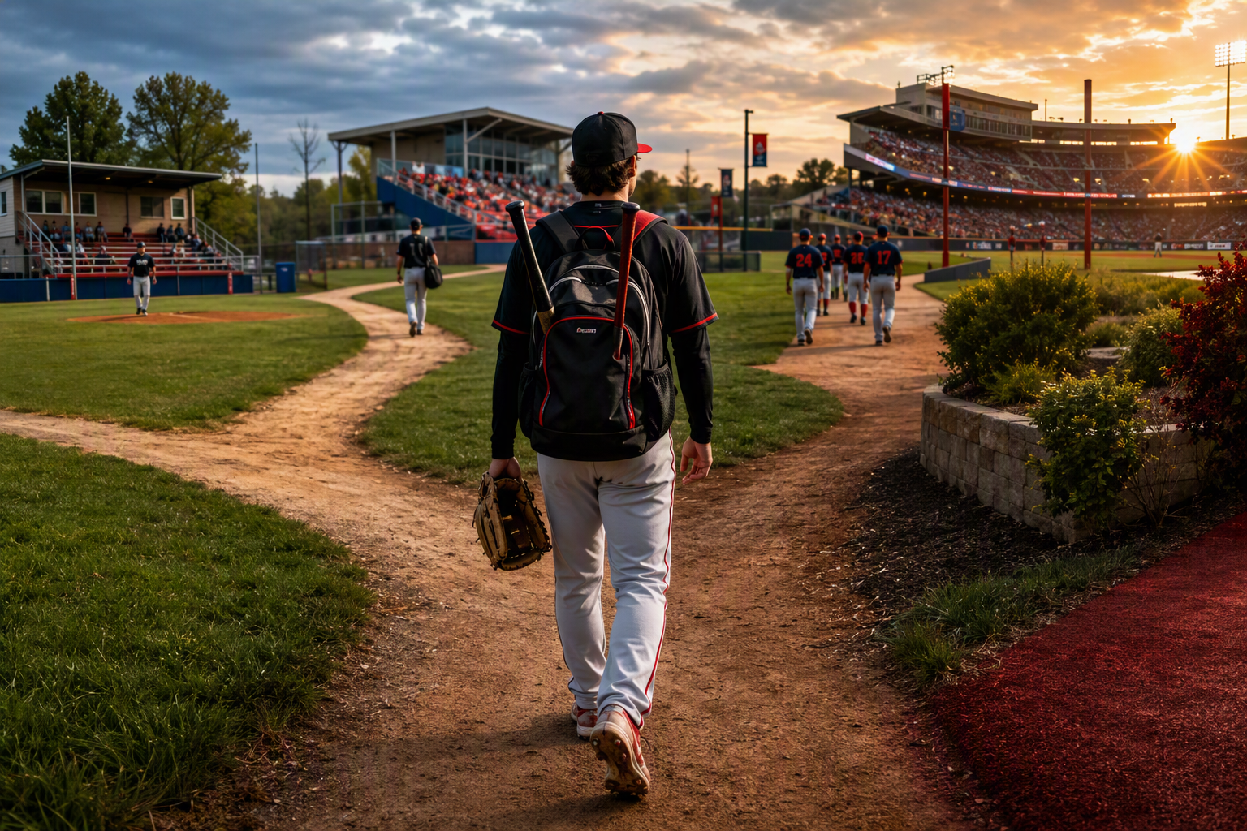
THE COMPETITION
Who is a high-school recruit competing against?
HIGH SCHOOL
Upside, projectability and limited college data
JUCO
College production plus physical development
D2 / D3
Proven results against college competition
PORTAL
Experience, verified role and immediate readiness
HUSTLE RESPONSE: develop athletes who are ready to compete for the right opportunity.
COAL CREEK HUSTLE • RECRUITING ROADMAP
04
Notes:
[Sources]
Visual on this slide was generated with Microsoft Copilot.
https://baseballmode.com/blogs/blog/college-baseball-recruiting-transfer-portal
[/Sources]

Slide 5

THE PATHWAY
There is more than one successful route
NAIA
D2
Four-year fit
Strong college baseball
JUCO
D3
D1
Develop + produce
Academics + opportunity
Right tools + timing
The best route is the one that creates meaningful playing time, development, academics and a sustainable financial fit.
Notes:
[Sources]
Visual on this slide was generated with Microsoft Copilot.
https://www.ncaa.org/division-iii/
https://www.ncaa.org/eligibility-center/transfer-rules-and-eligibility/
[/Sources]

Slide 6
WHY JUCO CAN WORK
Build the profile four-year coaches want
01
STRONGER
Physical maturity, strength and durability
02
POLISHED
Position-specific skill and game experience
03
PROVEN
College innings, at-bats and statistics
04
TRANSFER-READY
Academics and credits aligned to the next step
DEVELOP • PRODUCE • ADVANCE
Leave JUCO when the athlete has improved the four-year opportunity, not simply because one season has passed.
COAL CREEK HUSTLE • RECRUITING ROADMAP
06
Notes:
[Sources]
Visual on this slide was generated with Microsoft Copilot.
https://www.ncaa.org/eligibility-center/transfer-rules-and-eligibility/
[/Sources]

Slide 7
FROM THE TRACKER TO THE FIELD
Targeted college scrimmage and evaluation initiative
Coal Creek Hustle will use our recruiting tracker to prioritize outreach and work to create competitive opportunities with selected college programs.
COLORADO CORE
REGIONAL EXPANSION
EXTENDED TARGET
~2–3¼ HOURS
~3¼–4 HOURS
~4¾ HOURS
Northeastern Junior College
Western Nebraska CC
Dodge City Community College
Otero College
McCook Community College
Additional tracker schools as fit develops
Lamar Community College
Colby Community College
Trinidad State College
GOAL: combine competitive reps, campus exposure and direct interaction with college coaching staffs.
Scrimmages depend on coach interest, schedules and college eligibility/compliance requirements; inclusion is a targeted outreach plan, not a confirmed event.
Notes:
[Sources]
Coal Creek Hustle Expanded Recruiting Tracker (internal working file).
Tracker scope: NJCAA targets approximately six hours from Centennial, Colorado.
[/Sources]

Slide 8
THE JUCO DECISION
Move when the opportunity is better, stay when development still has value
TRANSFER
STAY + DEVELOP
Playing and producing
Limited playing time
Tools are ready for the target level
Physical development is incomplete
Credits and eligibility are on track
Coursework needs attention
A defined roster role exists
Another season can add leverage
COMPLIANCE + ADMISSIONS REVIEW REQUIRED
COAL CREEK HUSTLE • RECRUITING ROADMAP
07
Notes:
[Sources]
https://www.ncaa.org/eligibility-center/transfer-rules-and-eligibility/
[/Sources]

Slide 9
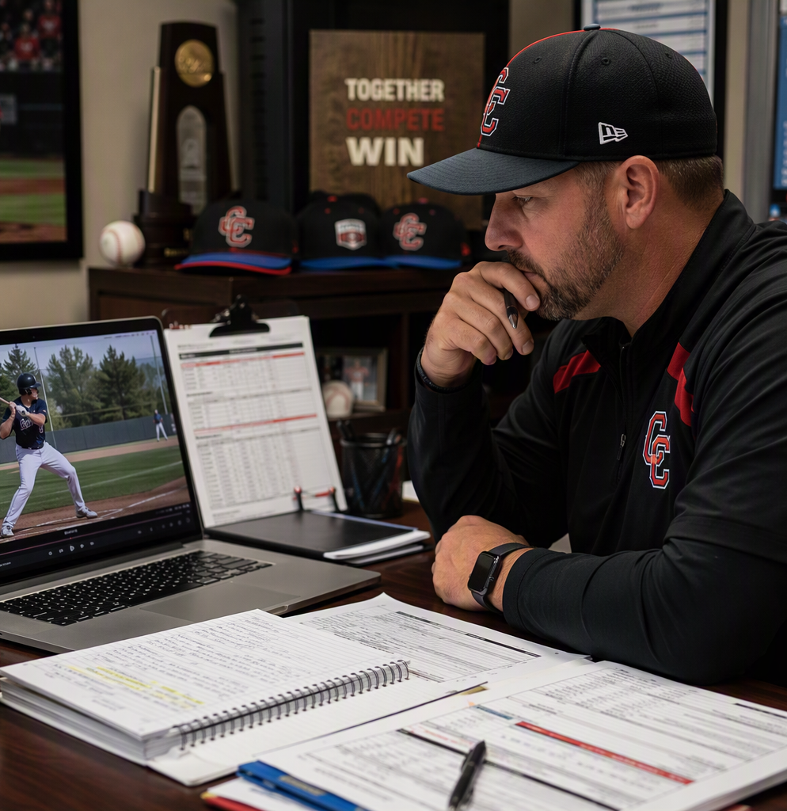
THE COMPLETE PLAYER
Five things athletes can control
1
ABILITY
Tools + performance
2
STRENGTH
A physical plan
3
VIDEO
Current + clear
4
ACADEMICS
Eligible + transferable
5
COMMUNICATION
Professional + consistent
Coaches recruit the athlete they can evaluate and project into a role.
COAL CREEK HUSTLE • RECRUITING ROADMAP
08
Notes:
[Sources]
Visual on this slide was generated with Microsoft Copilot.
[/Sources]

Slide 10
THE PARENT ROLE
Create structure without taking ownership away from the athlete
01
02
03
ACADEMICS
TARGET LIST
ATHLETE OWNERSHIP
Protect GPA, choose courses carefully and verify transferability.
Build across levels and compare depth charts, role, academics and cost.
The player communicates, follows up and asks the questions.
COAL CREEK HUSTLE • RECRUITING ROADMAP
09
Notes:
[Sources]
https://www.ncaa.org/eligibility-center/
https://www.ncaa.org/eligibility-center/transfer-rules-and-eligibility/
[/Sources]

Slide 11
COAL CREEK HUSTLE | BASEBALL
THE RECRUITING RUNWAY
Build early. Adjust often. Let development drive the next decision.
PREPARE
OUTREACH
EVALUATE
COMMIT
DEVELOP
Academics, strength, video
Emails, forms, events
Role, roster, cost
Best total fit
Perform + reassess
HUSTLE HELPS FAMILIES MAKE INFORMED DECISIONS AT EVERY STAGE
COAL CREEK HUSTLE • RECRUITING ROADMAP
10
Notes:
[Sources]
Coal Creek Hustle logo treatment based on the official organization wordmark: https://coalcreekhustlebaseball.com/16u-2025/
[/Sources]

Slide 12
ASK BETTER QUESTIONS (When College Coaches Reach Out)
The answers reveal role, opportunity and risk
ROSTER
DEPTH
SOURCE
DEVELOP
Where do you see me fitting?
Who returns at my position?
High school, JUCO or portal?
What resources are available?
PLAYING TIME
ACADEMICS
COST
COMPLIANCE
What is the pathway?
Does my major fit?
What is the full package?
Are my credits eligible?
A coach’s answer matters more than the division label.
COAL CREEK HUSTLE • RECRUITING ROADMAP
11
Notes:
[Sources]
https://www.ncaa.org/eligibility-center/transfer-rules-and-eligibility/
[/Sources]

Slide 13
FIND THE RIGHT COLLEGE.
DEVELOP.
PERFORM.
ADVANCE.
Prepare athletes to compete for opportunity in a market that values production, physical development, academics and proven fit.
Notes:
[Sources]
Visual on this slide was generated with Microsoft Copilot.
Coal Creek Hustle logo treatment based on the official organization wordmark: https://coalcreekhustlebaseball.com/16u-2025/
[/Sources]

